Slide 1
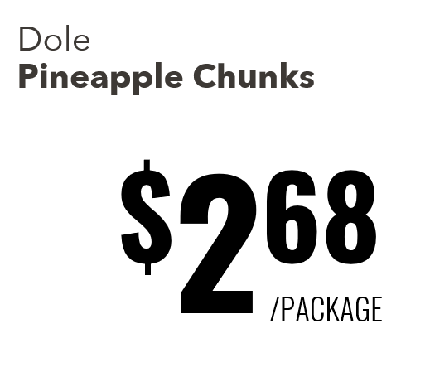
Product identifier (if applicable). Ex: 3rd party brand, Skinless, bone-in, USDA rating, this isn’t always filled in (Example: Flan)
Product name on label
Price per item or price per pound depending on if it’s a variable weight product.
Will only be either “Package” or “LB” dependent on if this is a variable weight item

Slide 2
Dole Pineapple Chunks
$2⁶⁸
/PACKAGE

Slide 3
Wagyu Beef Tomahawk Steak
$48⁹⁸
/LB

